Slide 1

Advanced Driver-Assistance Systems
Presented by Elyes Khechine
GitHub

Slide 2
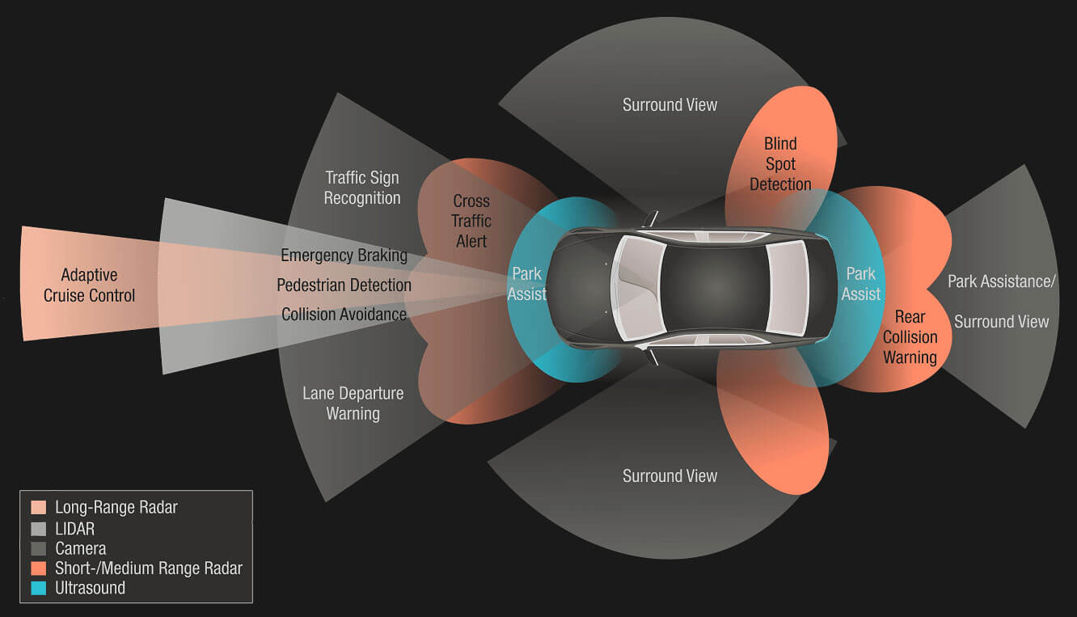
ADAS in Modern Autonomous Vehicles

Slide 3
01
Park Assist
Also known as Automatic Parallel Parking (APP)

Slide 4
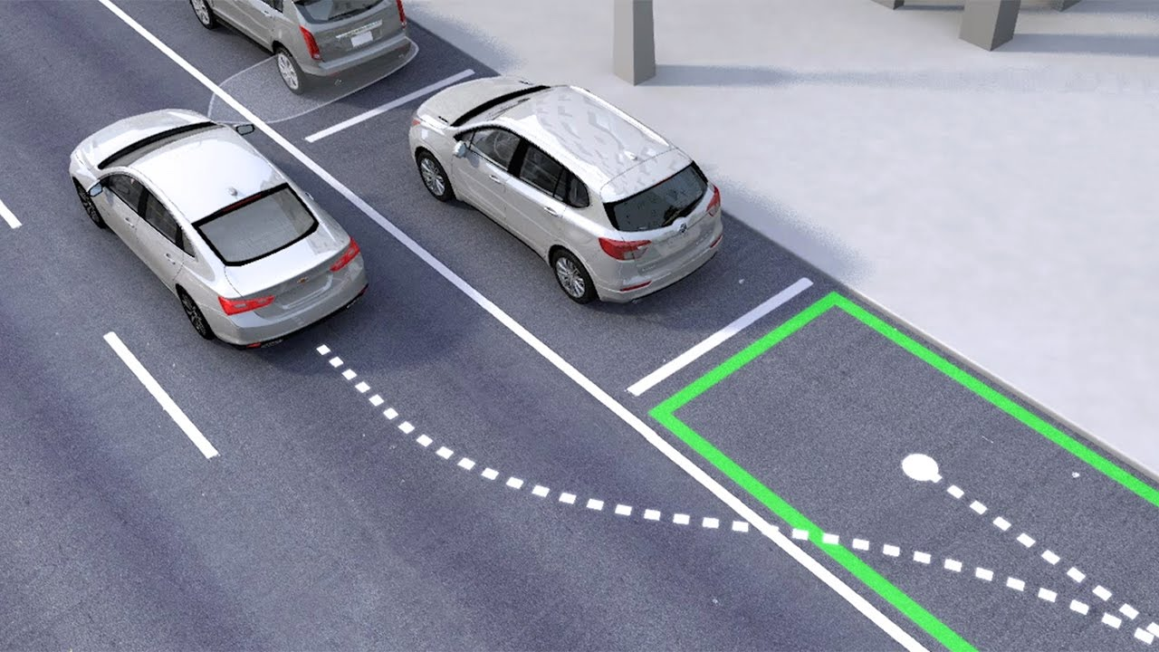
What is it?
Helps guide the driver into a parallel parking spot after searching and finding a viable option. The driver still is responsible for braking and monitoring their environment.

Slide 5
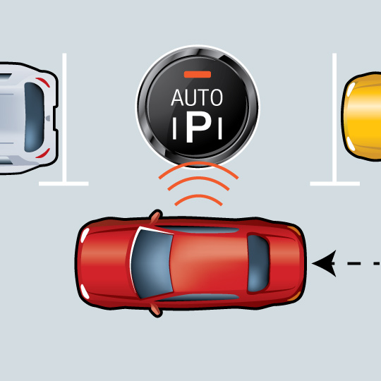
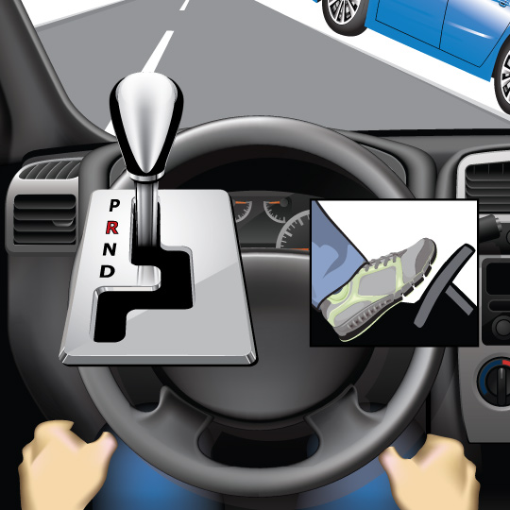
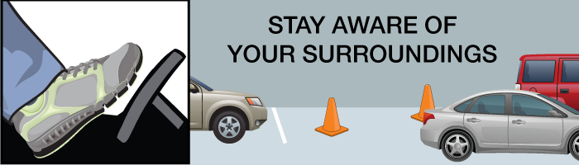
How does it work?
01
02
03
Activation
Wheel Take Over
Braking
Advanced sensors read the gaps between cars in the area where the driver wants to park. The feature won’t activate if there isn’t sufficient room to parallel park, which helps ensure that the car won’t bump into any nearby cars.
When activated, this feature can then take over some of the vehicle’s steering and acceleration functions needed to park.
The driver is responsible for braking when using automatic parallel parking. They can override the automatic parallel parking maneuver by grabbing the steering wheel.

Slide 6
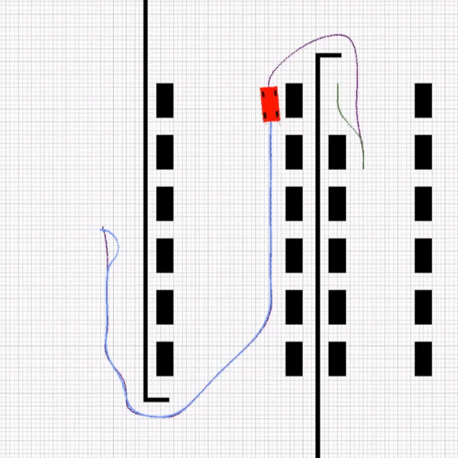
Automatic Parallel Parking Implementation Example
This repository contains a python implementation of an automatic parallel parking system in a virtual environment that includes path planning, path tracking, and parallel parking. The agent navigates its route through the environment and is directed to the assigned park location by the MPC controller.
Repo Link: https://github.com/Pandas-Team/Automatic-Parking
At first, the agent will find a path to park position then it will compute the arriving angle. Based on the arriving angle, the agent chooses a coordinate as ensure1. After that, the parking path is planned from ensure1 to ensure2 using 2 circle equations. MPC (Model Predictive Controller) controls the agent and car parks in ensure2 coordinate.

Slide 7
02
Lane Keeping Assist (LKAS)

Slide 8
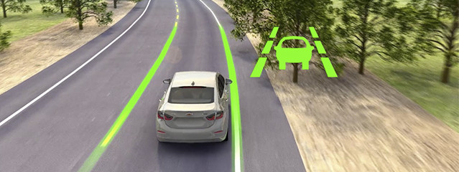
What is it?
Lane keeping assist uses a video camera to detect the lane markings ahead of the vehicle and to monitor the vehicle's position in its lane. It then provides automatic steering and/or braking to keep the vehicle in its travel lane.

Slide 9
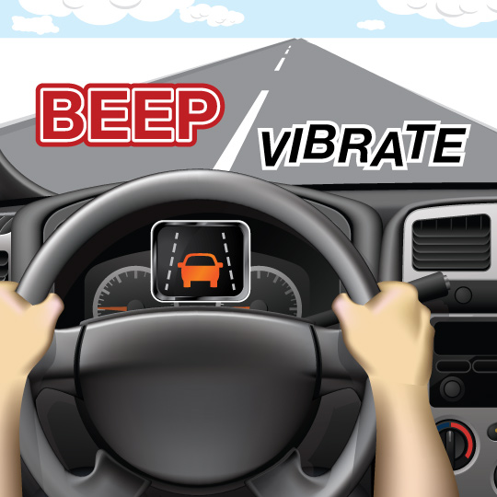
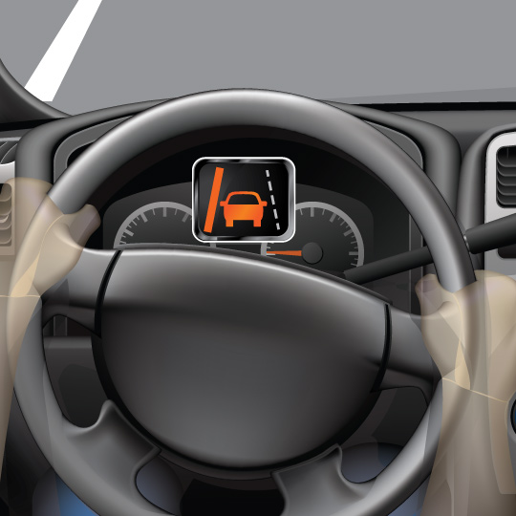
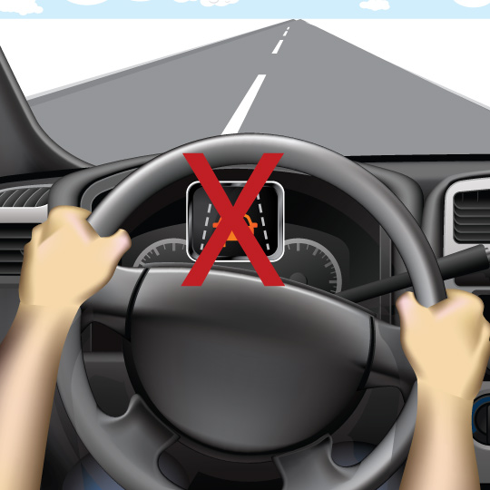
How does it work?
01
02
03
Lane Monitoring
Wheel Take Over
Engage
The driver may receive an alert via a sound, flashing light or vibration if they drift out of the lane.
If the driver doesn't take action, this feature may gently steer them back to the center of the lane.
Slightly pulling the wheel will disable the lane keeping assist on most cars.

Slide 10
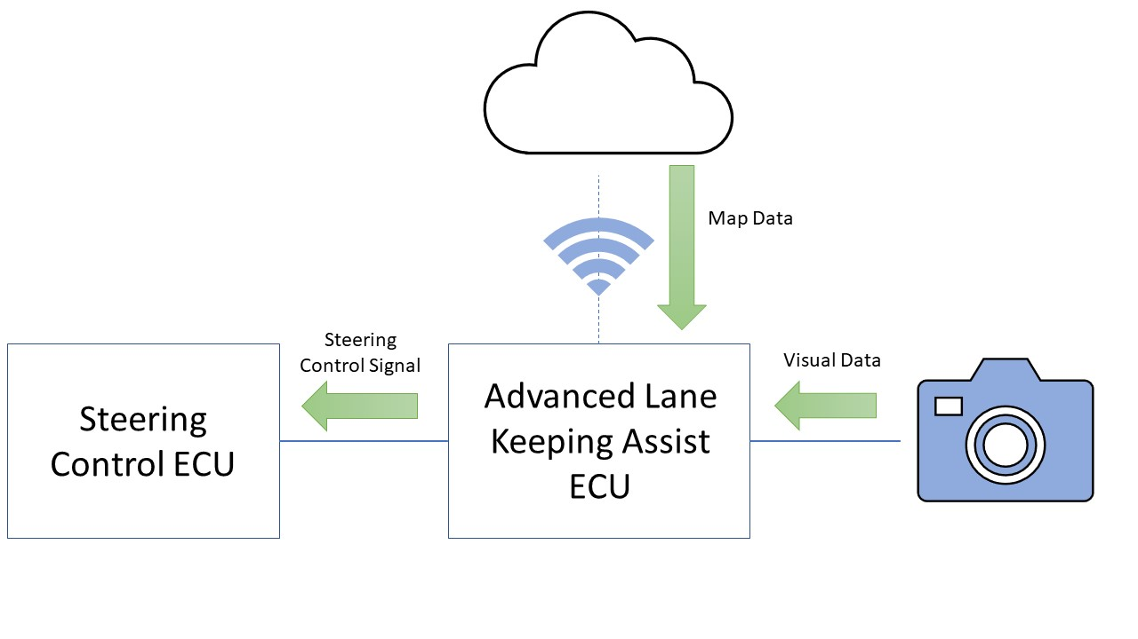
LKAS Implementation using Matlab and Simulink.
This project was implemented using Matlab and Simulink. The main algorithm used in the Matlab section of the project was the Hough transform as well as the Sobel edge detection algorithm.
Repo Link: https://github.com/EmmaNiBhriain/Lane-Keeping-Assist
It takes data from external sensors such as cameras to analyze the road ahead. This data is combined with data from the cloud which indicates the type of road that the car is on, for example if the car is on a one-way road it does not need to calculate the position of two lanes as there will be no on-coming cars. In the event that the car moves onto a road where there is road markings visible, this system will turn off and another lane keeping assist algorithm can take over.

Slide 11
03
Automatic Emergency Braking (AEB)

Slide 12
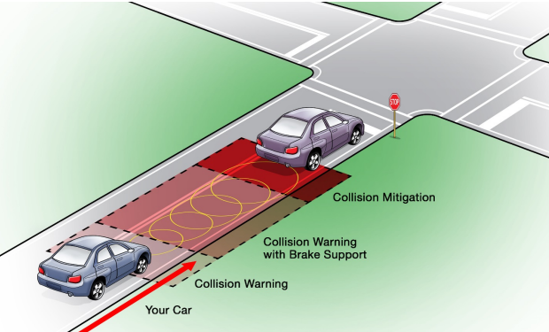
What is it?
Automatic Emergency Braking (AEB) is a system that applies the brakes to their maximum to avoid a stopped car ahead or a car turning in front of the driver.

Slide 13
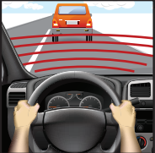
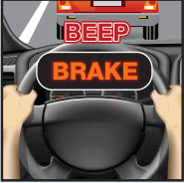
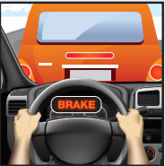
How does it work?
01
02
03
Always-On Scan
Alert
Take Action
If collision is possible, warning tones and other visual alerts would activate to alert the driver.
If collision is imminent and the driver hasn’t responded, the car will automatically brake hard.
The system scans the road for objects and possible hazards.

Slide 14
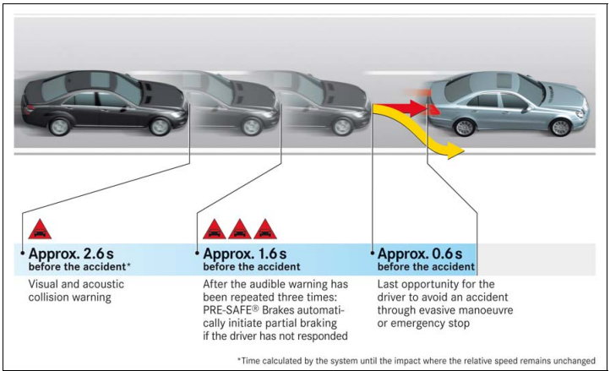
Warnings provided by PRE-SAFE Brake in a typical rear-end collision situation

Slide 15
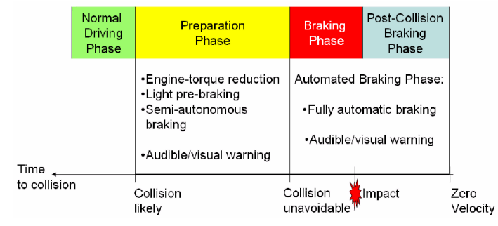
Collision Mitigation Phases

Slide 16
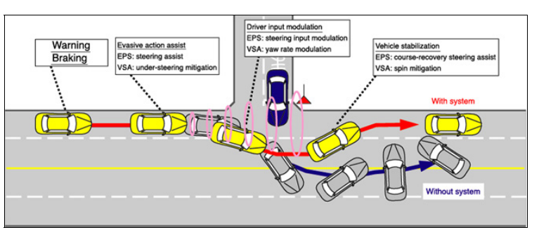
Forward Obstacle Assistance System

Slide 17
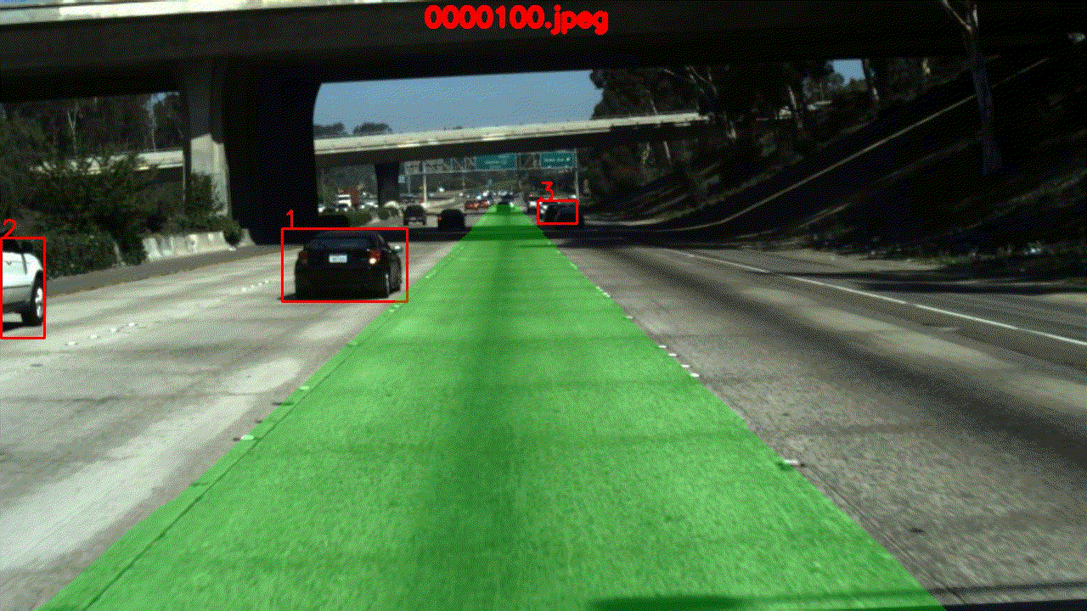
AEB Implementation using Deep Learning
This repository contains code for a project whose goal is to Implement Automatic Emergency Braking System using a monocular camera. This model is trained on tusimple lane dataset.
Repo Link: https://github.com/kuldeepbishnoi/Automatic-Emergency-Braking
LaneNet
LaneNet algorithm is a state of art deep convolution neural network which is used to detect lanes and is implemented using tensorflow.
DeepSORT
We use YOLO v3 algorithm to perform vehicle detections. Then we take this output feed it to DeepSORT in order to create a highly accurate vehicle tracker.
Automatic Emergency Braking System
This feature can sense incoming(traffic coming to ego lanes) and slow(as well as stopped) traffic ahead and urgently apply the brakes.

Slide 18
04
Rear Cross Traffic Alert (RCTA)

Slide 19
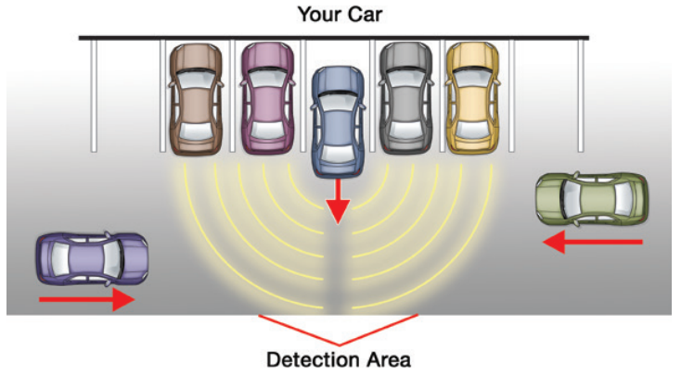
What is it?
Rear Cross Traffic Alert is designed to help the driver back out of spaces where they may not see approaching traffic, as sometimes happens in parking lots. Rear cross traffic alert monitors two areas behind the driver for vehicles approaching from the right or left.

Slide 20
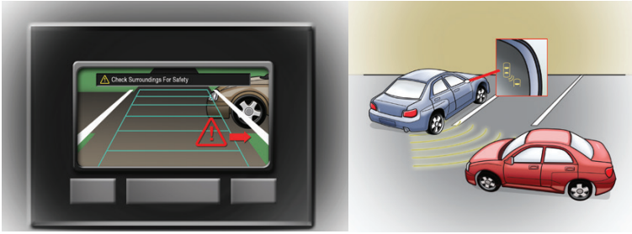
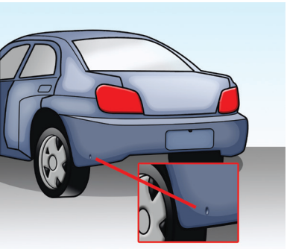
How does it work?
Warning
Sensor Monitoring
Sensors are located at each side of the vehicle near the rear bumper and look like buttons. Typically, the rear cross traffic alert will use the same sensors as a blind spot monitoring system.
The RCTA system will alert the driver when other vehicles are detected near or in the backing path. Once the rear end of the vehicle is beyond adjacent objects and vehicles, the rear cross traffic alert system will then have a clear view of traffic approaching from the left or right.

Slide 21
ADAS Sensors & Architecture
How can we implement these systems?

Slide 22
Integrated ADAS Architecture
Sensor Fusion
Data Processing
Complexity Reduction
Highlight Important Features
Sensors
Steering
Control
Ethernet
Sensor Processor
MIPI
Camera
ADAS / AD Processor
Brakes
LiDAR
MIPI
Display
Radar
QSP1
OSP1
xSP1
LPDDR
GDDR
HBM
UFS
SD
eMMC
DDR
Ultrasound
PCIe
DRAM
FLASH
DRAM
FLASH
Storage

Slide 23
Integrated AV Architecture
Sensor Fusion
Data Processing
Complexity Reduction
Highlight Important Features
Sensors
Steering
Control
Ethernet
Sensor Processor
MIPI
Stereo Camera
ADAS / AD Processor
Brakes
MIPI
Radar
Display
QSP1
OSP1
xSP1
Ultrasound
LPDDR
GDDR
HBM
UFS
SD
eMMC
DDR
PCIe
DRAM
FLASH
DRAM
FLASH
Storage

Slide 24
TUNMARS Integrated Architecture
Sensor Fusion
Data Processing
Complexity Reduction
Highlight Important Features
NVIDIA DRIVE AGX Pegasus OA DevKit
Sensors
Steering
Control
NVIDIA DRIVE ConnectX-7 Network Porcessing Module
NVIDIA DRIVE A100 GPU
NVIDIA DRIVE Orin Module
MIPI
Stereo Camera
Brakes
MIPI
Radar
Display
eMMC 5.1
Ultrasound
GDDR6
LPDDR5
PCIe
DRAM
FLASH
DRAM
Storage

Slide 25
Hybrid Data Sensor Fusion Concept
IMU
GNSS
Smart Sensors
Stereo Camera
Up to 1 Gbits/s
Sensor Fusion
Vehicle Control
Radar
Up to 5 Gbits/s
Ultrasound
High-Speed Object-Level
Data Transmission
Digital Maps
Data
Preprocessing

Slide 26
Raw Data Sensor Fusion Concept
V2X
GPS
Sensors
Camera
Up to 24 Gbits/s
LiDAR
Up 1 Gbit/s
Sensor Fusion
Vehicle Control
Radar
Up to 120 Gbits/s
Ultrasound
High-Bandwidth
Raw Data Transmission
Digital Maps

Slide 27
Hybrid Data Sensor Fusion Concept
V2X
GPS
Smart Sensors
Camera
Up to 1 Gbits/s
Up to 100 Mbits/s
LiDAR
Sensor Fusion
Vehicle Control
Radar
Up to 5 Gbits/s
Ultrasound
High-Speed Object-Level
Data Transmission
Digital Maps
Data
Preprocessing

Slide 28
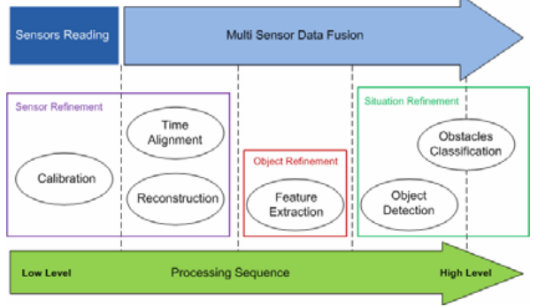
Sensor Fusion Processing

Slide 29
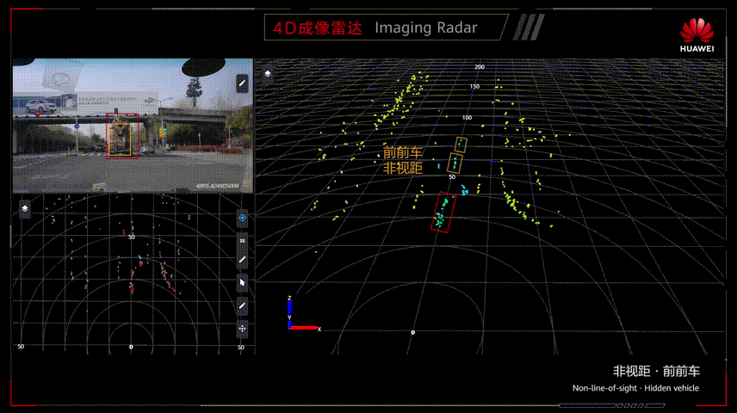
4D Imaging Radars
4D radar uses a large Multiple Input Multiple Output (MIMO) antenna array for echolocation. It sends signals that bounce off objects in the environment and captures the results to calculate the size, location, direction, speed, and elevation of objects in the environment.
4D radar replaces older technologies like cameras, radar, and Lidar that are used for computer vision and autonomous driving in vehicles.
4D radar has the advantage of being able to work in any weather and any level of lighting, detect elevation, speed, and direction accurately, and detect targets behind other objects in the environment.

Slide 30
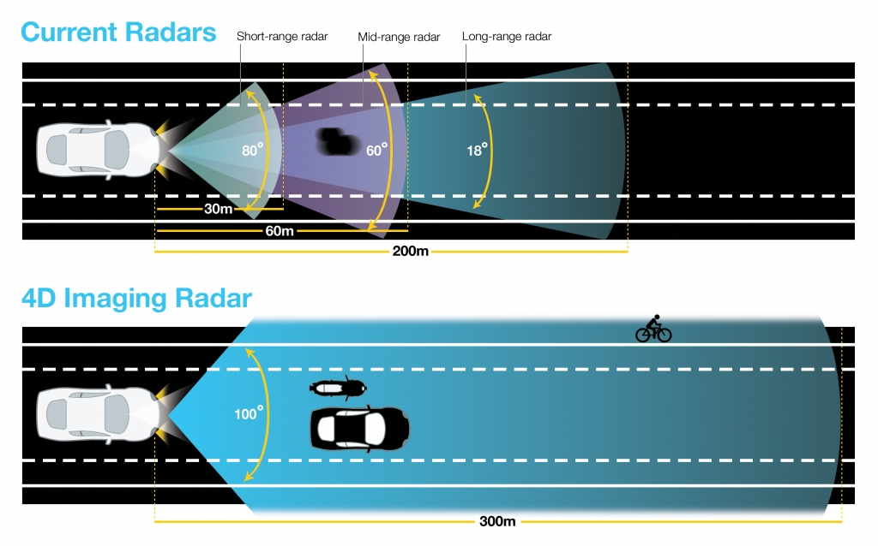
Current Radars VS. 4D Imaging Radars

Slide 31
ADAS Sensors Comparison (1)
 | Camera | 3D Imaging Radars | LiDAR | 4D Imaging Radar
Angular Resolution | <=0.1° | 1.2° | 0.1° | 0.6°-1°
Range Accuracy | 5cm | 10cm | <=5cm | <=5cm
Maximum Range | 250m | 200m | 100m | 350m

Slide 32
Sensors Comparison
 | Stereo Camera | 3D Flash LiDAR | LiDAR | 4D Imaging Radar
Angular Resolution | <=0.1° | <1.9° | 0.1° | 0.6°-1°
Range Accuracy | <50cm | <35cm | <=5cm | <=5cm
Maximum Range | 300m | 200m | 100m | 350m
Cost | $200+ | $2400+ | $1200+

Slide 33
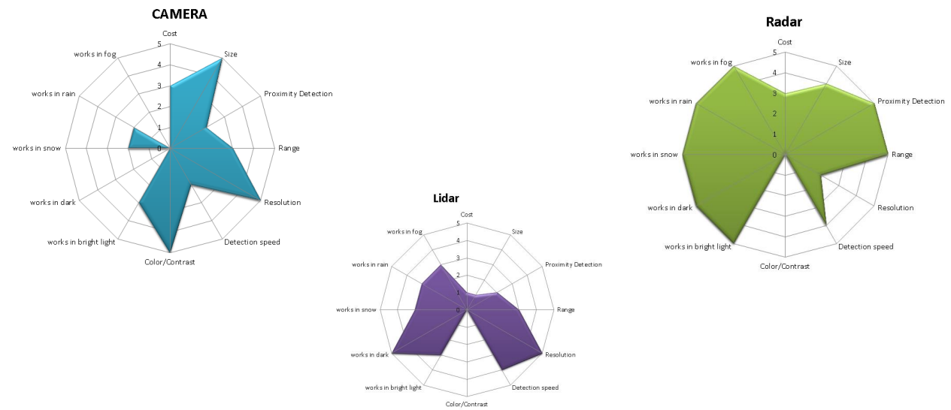
ADAS Sensors Comparison (2)

Slide 34
THANKS

